Slide 1
TITLE: SB- FOOD ORDERING APP
TEAM MEMBERS:
NITHEA S
PRATHYUSHA U
NIVEDHA V
PAVITHRA G R

Slide 2
ABSTRACT
This presentation introduces SB Foods, a web application designed for seamless online food ordering,
featuring a diverse menu of food items that provide users with an intuitive and efficient ordering experience.
Key Features:
Structured Layout: The application utilizes a clean and organized design that ensures easy navigation
and accessibility for all users.
Responsive Design: The visual elements adapt to various screen sizes, maintaining an attractive and
user-friendly interface across devices.
Dynamic Interactions: Real-time updates and interactive elements enhance user engagement, allowing
for a more satisfying and responsive ordering experience.
The main objective of SB Foods is to provide a simplified food ordering platform that caters to a variety of user preferences and allows for fast and easy ordering, even during unconventional hours.
By leveraging these web development techniques, SB Foods aims to deliver a modern and user-centric
food ordering platform.

Slide 3
INTRODUCTION
Welcome to the presentation of SB Foods, an innovative web application designed to revolutionize the food ordering experience. With the rapid increase in online food delivery, there is a need for apps that provide intuitive user interfaces, fast service, and detailed information about food items. SB Foods addresses these requirements by providing an easy-to-navigate platform with detailed descriptions, reviews, and real-time order tracking.
Developed with a focus on user experience, SB Foods combines a visually appealing design with interactive features that enhance customer engagement. Throughout this presentation, we will explore the application's key functionalities, its design principles, and the web development techniques employed to create a seamless ordering process. Join me as we delve into how SB Foods is setting a new standard for online food ordering.

Slide 4
Proposed/Future Implementation
Current Features:
User Profiles: This allows users to save their previous orders and preferences, making future orders quicker and easier. A user can also manage settings, track their order history, and leave reviews for the dishes they’ve tried.
Dish Exploration: This feature enhances the user experience by allowing them to easily find dishes that suit their tastes. It also includes customer reviews and ratings to aid in decision-making.
Order Tracking: This ensures transparency and keeps users informed about when to expect their orders. It adds convenience by providing real-time notifications, reducing user anxiety about delayed deliveries.
Checkout Process: A streamlined, easy-to-use checkout reduces cart abandonment and ensures a smooth and fast ordering experience. The ability to save payment methods adds convenience for repeat orders.

Slide 5
Future Enhancements:
AI-Based Recommendations: The system will use machine learning algorithms to understand patterns in user preferences (e.g., favorite dishes, frequently ordered items) and offer recommendations accordingly. For instance, if a user frequently orders Italian food, the app may highlight new or popular Italian dishes.
Mobile App: Mobile apps are more convenient for users who prefer to order food on the go. They increase user retention by offering a more accessible and responsive platform with additional features like push notifications for order updates or promotions.
Multilingual Support: The app’s interface and menu details will be available in different languages. Based on user location or settings, the app will switch to the preferred language, improving accessibility for non-English speakers.
Loyalty Programs: Loyalty programs are a proven way to retain customers and encourage repeat orders. By rewarding loyal users, the app can increase engagement and build a stronger, long-term user base. The subscription program could also create a steady revenue stream for the platform.

Slide 6
PROJECT DESCRIPTION
The SB Foods web application is a comprehensive platform designed to facilitate online food ordering. The project aims to provide a seamless and user-friendly experience for customers looking to browse and order food from a diverse menu. Key components of the application include:
Home Page: The welcoming entry point of the application features an engaging layout that highlights promotional offers, popular dishes, and easy navigation to other sections.
Food Items Section: This section showcases a variety of food options, allowing users to explore different categories, view detailed descriptions, and make informed choices. Each item includes appealing images, ingredients, and pricing information to enhance the decision-making process.
About Us Page: Here, users can learn about the mission and vision of SB Foods, including the values that drive the company. This page fosters trust and connection with customers, reinforcing the brand's commitment to quality and service.
FAQ Section: To address common queries, this section provides clear and concise answers to frequently asked questions, helping users find information quickly and enhancing their overall experience.

Slide 7
USE CASE SCENARIO
In the SB Foods web application, a customer begins by accessing the site through a web browser, where they are welcomed by an engaging Home Page that highlights various food categories and promotions. They then explore the Food Items section, selecting dishes they wish to order. Once their selections are made, the customer simply proceeds to checkout, entering their delivery information. After submitting their order, they receive a confirmation message, ensuring a smooth and user-friendly experience while enjoying their favorite meals from the comfort of their home. The customer then waits for their food to be delivered, with the option to provide feedback or rate their experience, ensuring a seamless and satisfying online ordering process.

Slide 8
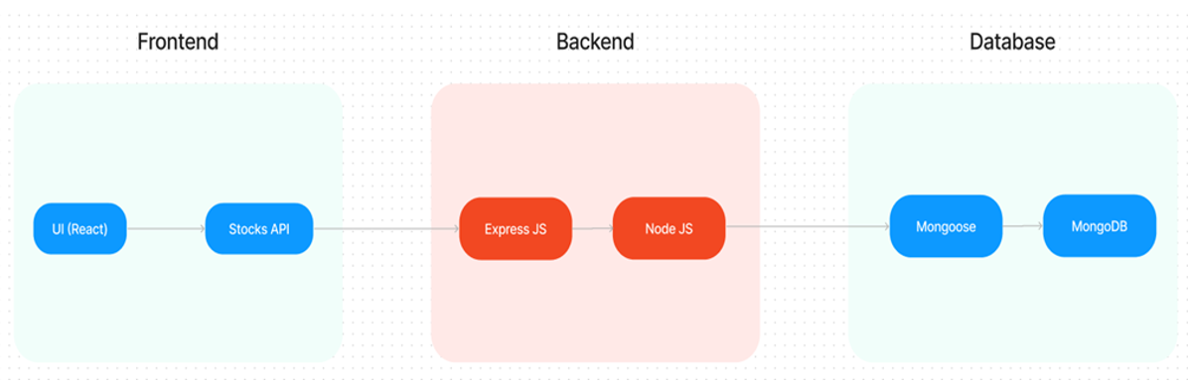
TECHNICAL ARCHITECTURE

Slide 9
FRONTEND TECHNOLOGIES
Technologies Used:
HTML & CSS:
HTML is used to structure the web pages, ensuring the correct placement of various UI components.
CSS styles the application, focusing on layout, color schemes, and fonts to enhance the user experience.
CSS frameworks (like Bootstrap) provide pre-designed components, ensuring the app is responsive and maintains a consistent look across devices.
JavaScript:
Handles dynamic interactions on the webpage, such as menu navigation, user inputs, and cart updates in real time without refreshing the page.
React.js:
A popular front-end library for building the UI. React's component-based architecture allows for reusable code blocks and better code management.
State Management: React hooks and state management libraries (like Redux) are used to manage the app’s internal state, especially for order updates, cart status, and user profiles

Slide 10
Features:
Responsive UI:
Mobile-first design: The UI is designed with mobile users in mind first, ensuring that the layout, images, and buttons are perfectly aligned for smaller screens.
Cross-device compatibility: Media queries in CSS are used to ensure the app adjusts fluidly across mobile, tablet, and desktop devices, providing a consistent experience regardless of screen size.
Components: Key components like navigation bars, product listings, and cart summaries dynamically adjust based on the user’s device.
User Authentication:
Users can sign up or log in with their email, username, and password, with authentication tokens stored in local storage or session storage for continuous sessions across visits.
Secure forms are designed with client-side validation to check for valid inputs (e.g., email format, password length) before sending the data to the server.
Order Management:
Quantity Adjustments: Quantity selectors allow users to choose how many items of each product they wish to order, with instant updates to the price.
Order Review: Before placing an order, users can review their selected items in the cart page, ensuring they have selected the right items and quantities.

Slide 11
Backend Technologies And Database Integration
Technologies Used:
Node.js:
A JavaScript runtime built on Chrome’s V8 engine, enabling efficient, event-driven server-side programming. It handles multiple requests simultaneously, making it ideal for an app where many users might place orders concurrently.
Express.js:
A lightweight, flexible web application framework built on top of Node.js, used to create APIs that handle HTTP requests (GET, POST, PUT, DELETE). It structures the backend and facilitates communication with the frontend.
Database Used: MongoDB (NoSQL)
Data Models:
Users: Stores user information, including name, email, and encrypted passwords.
Orders: Stores order history with user IDs, item IDs, total cost, and timestamps.
Products: Stores details about the food items, including descriptions, price, and availability.
Admin: Admins manage products and orders for their respective restaurants.

Slide 12
Integration of Frontend and Backend
Frontend to Backend Communication: The frontend interacts with the backend via API calls using Axios. Whenever a user places an order, data is sent to the backend, which interacts with the database to store and retrieve information.
API Workflow:
User logs in: API authenticates the user and returns a token.
User places an order: Frontend sends order details to the backend API, which stores the information in MongoDB.
Admin updates a menu item: Backend receives the request, validates the input, and updates the product data in the database.

Slide 13
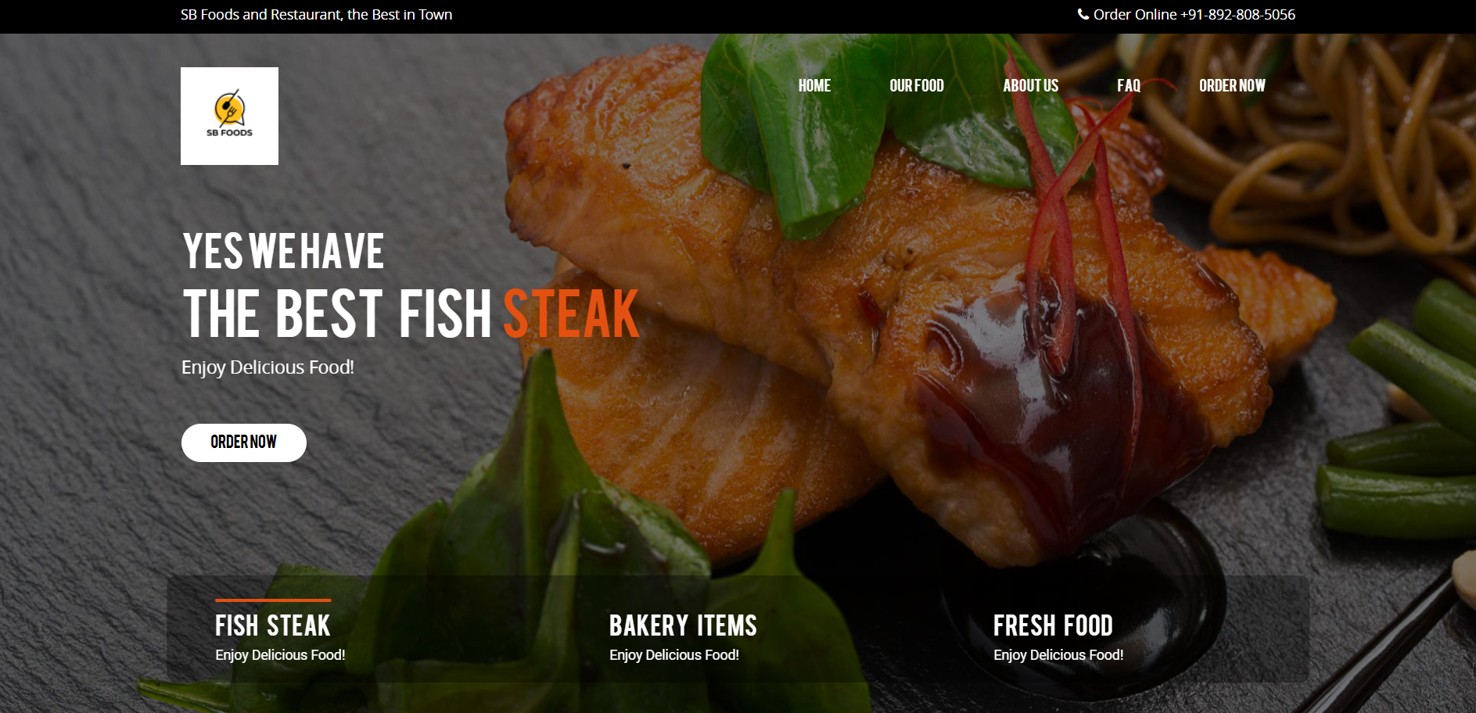

MODEL: HOME PAGE

Slide 14
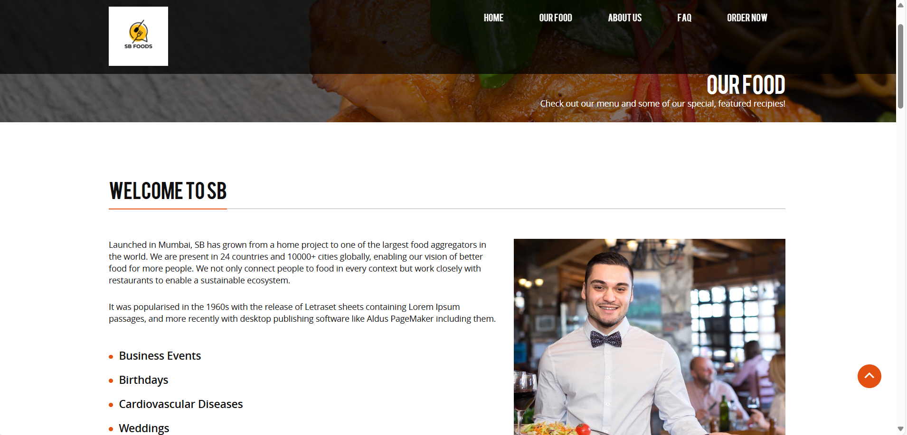
OUR FOOD

Slide 15
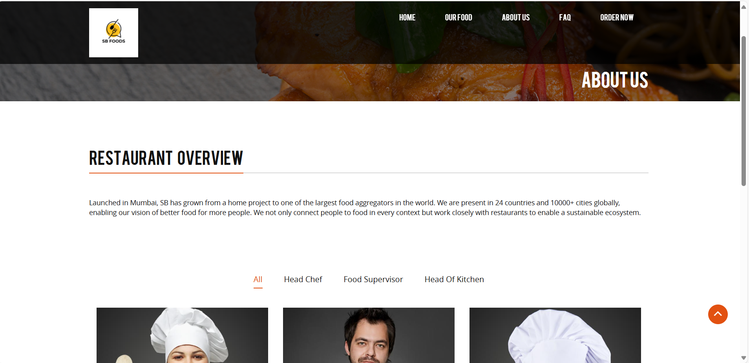
ABOUT US

Slide 16
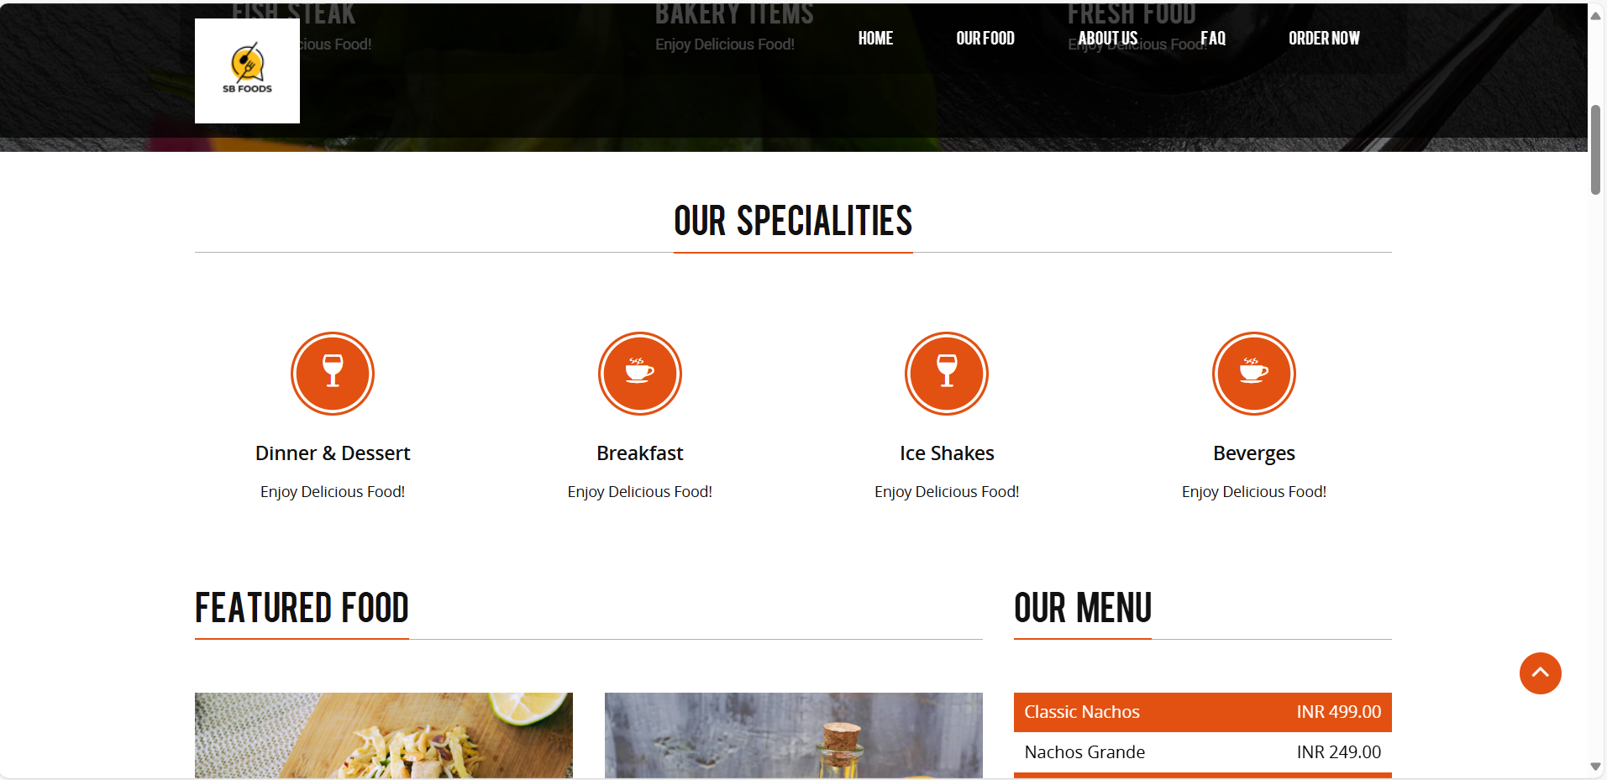
SPECIALITIES

Slide 17
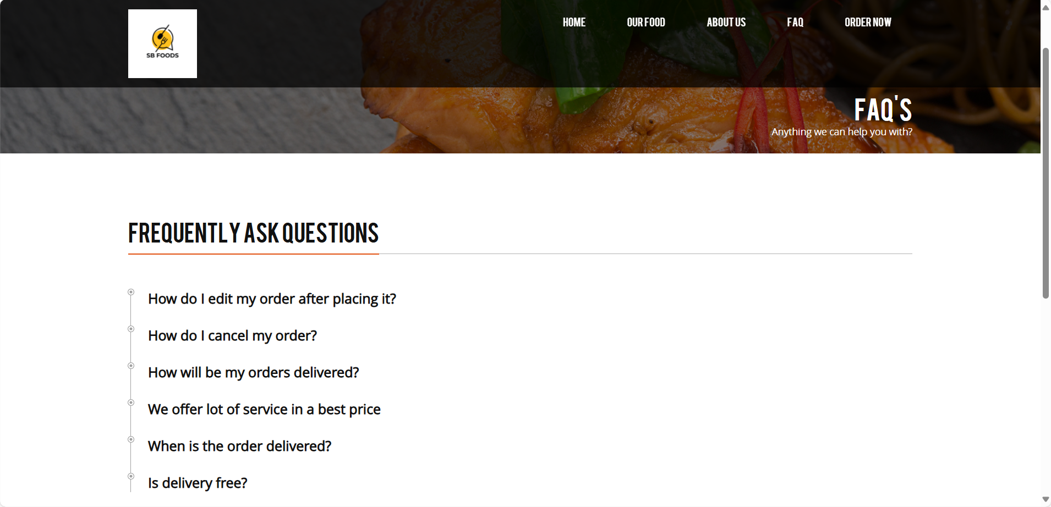
FREQUENTLY ASKED QUESTIONS

Slide 18
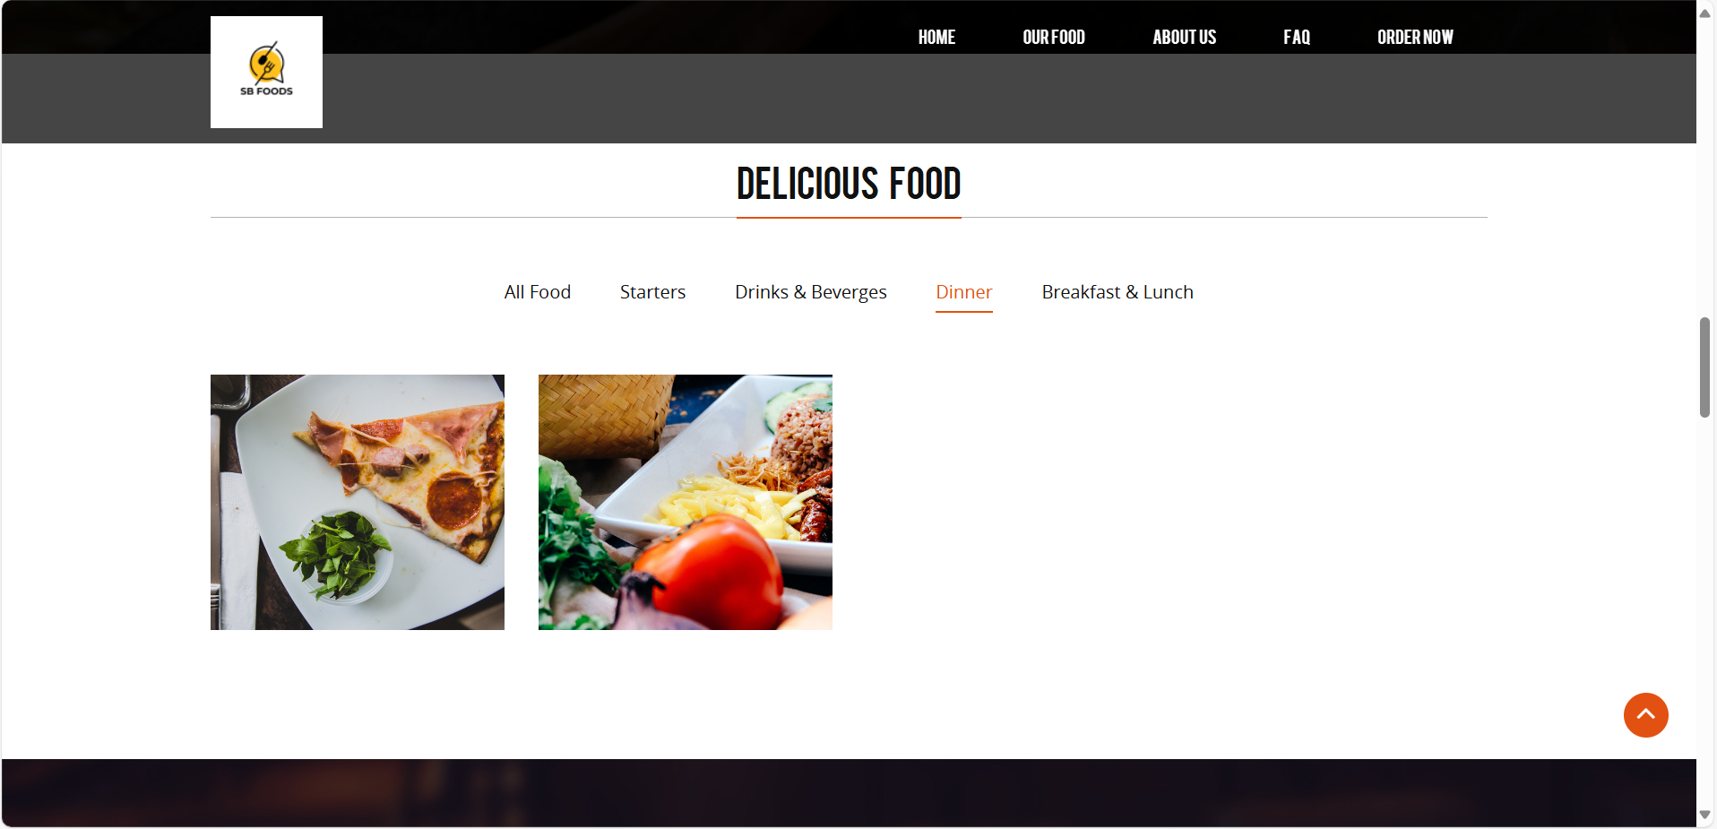

Slide 19
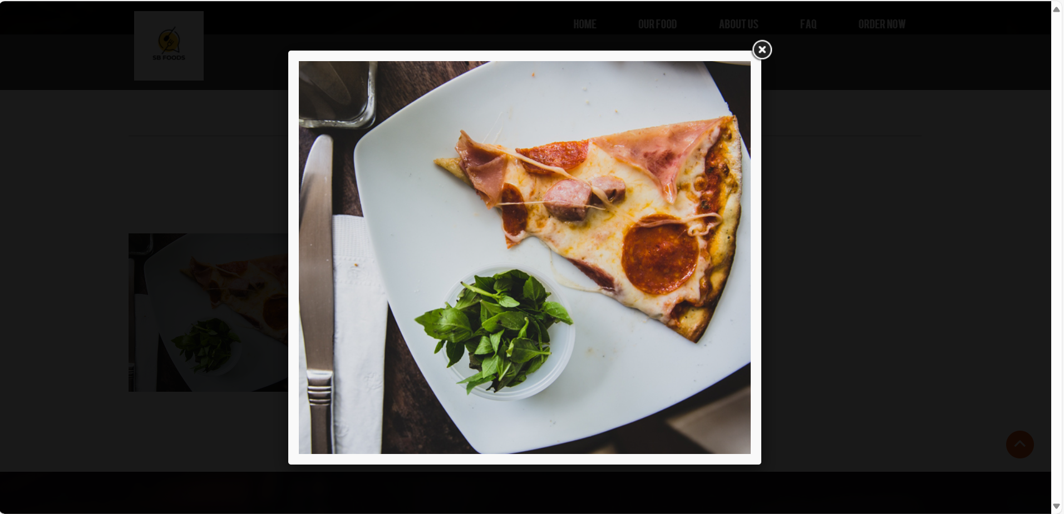
FOOD IMAGES

Slide 20
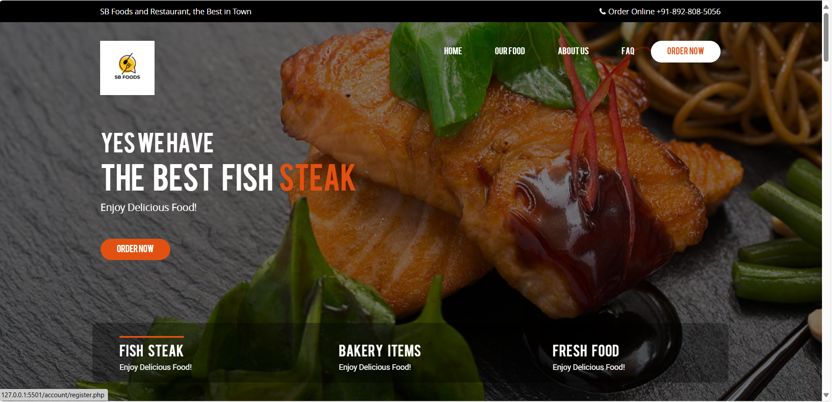
ORDER NOW

Slide 21
CONCLUSION:
The SB Foods - Food Ordering App successfully addresses the growing demand for a seamless, efficient, and user-friendly digital food ordering experience. By leveraging the power of the MERN stack (MongoDB, Express.js, React.js, Node.js), the application provides a dynamic and responsive platform that caters to both users and administrators.
From the user's perspective, the app simplifies the food ordering process with features like real-time menu browsing, personalized recommendations, secure payment gateways, and order tracking. These features contribute to enhancing user satisfaction and engagement, ensuring that every aspect of the ordering experience is streamlined and enjoyable.
For restaurant administrators, the app provides a robust admin panel to manage menu items, track orders, and handle customer feedback. The role-based access ensures that administrators can efficiently manage their operations while keeping the customer experience smooth.
Looking ahead, the potential for future growth and improvement is vast. The addition of AI-based recommendations, mobile app development, multilingual support, and loyalty programs will further enhance the platform’s functionality, improving both user retention and market reach.
In conclusion, SB Foods demonstrates how modern web technologies can be utilized to create a scalable, user-centric food ordering platform that is well-equipped to adapt to the evolving needs of the food delivery industry.

Slide 22
THANK YOU ☺

